Slide 1
Adversarial Graph Embeddings for Fair Influence Maximization over Social Networks
Team:
Mr. Vikas 420233
Mr. Krishna Sandeep 420247
Mr. M. Rahul 420206
Mentor:
Mrs. B.S.S. Monica

Slide 2
Adversarial Graph Embeddings for Fair Influence Maximization over Social Networks
Credits:
Moein Khajehnejad :Monash University
Ahmad Asgharian Rezaei :RMIT University
Mahmoudreza Babaei :Max Planck Institute for Software Systems
Jessica Hoffmann : RMIT University
Mahdi Jalili :The University of Texas at Austin
Adrian Weller :University of Cambridge, Alan Turing Institute
Year of publication : 11th May 2020

Slide 3
Problem Statement
To identify a set of seed nodes in social network, which can maximize Fairness (Balance) of influence in social network using Graph embeddings.

Slide 4
Literature review:
Seed users : A set of initial users who are used to start the diffusion of information through a network.
Influence Maximization : The process of selecting a set of k seed users that will optimally diffuse information through a network.
Submodularity: Sub modularity characterizes the diminishing returns property, indicating that the marginal gain of adding a node to a larger seed set decreases as the seed set size increases in influence maximization algorithms.
Balance/Fairness : When categorical ratio between the nodes in the network is preserved in the active set.

Slide 5
Embedding : Embedding problem proposes to map nodes to a low dimensional space such that the network structure can be reconstructed.
Generative Adversarial Network (GAN) : This is an advanced AI architecture that pits two neural network’s against each other to generate realistic data.
Autoencoder : Autoencoder learn a compressed, efficient representation of input data, typically for the purpose of dimensionality reduction or feature learning.
Discriminator : This distinguishes between the embeddings of two communities and rejects them if not similar

Slide 6
Previous work
In the previous semester we worked using CELF , CELF++

Slide 7
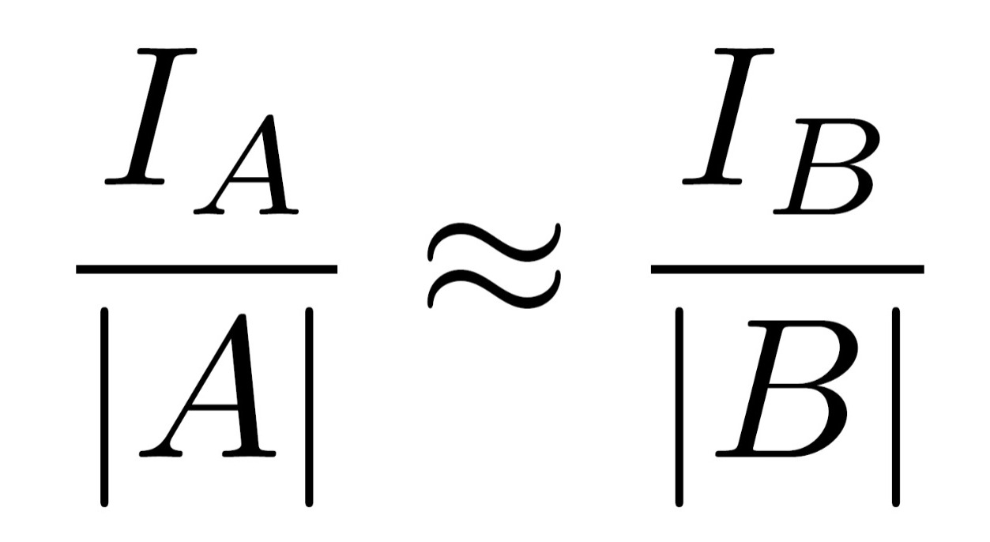
Fairness (balance)
Let us assume that there are only two groups A and B for simplicity. Let I_{A} and I_{B} be the expected total number of influenced nodes belonging to groups A and B, respectively. We say a spreading process is fair if, by the end of it, we have:

Slide 8
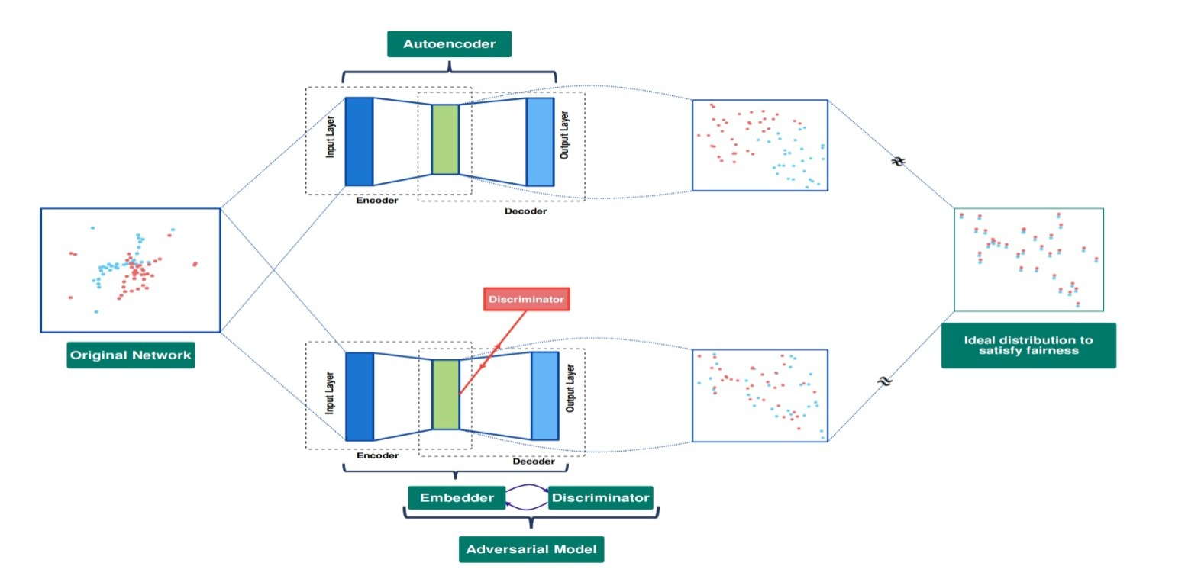
Architecture of our model

Slide 9
Methodology
Now we design an adversarial setting in which the embedder plays against a discriminator.
In this setting, the discriminator distinguishes between the embeddings of the two communities. Concurrently the embedder tries to generate embeddings that are indistinguishable by the discriminator.
In other words, the discriminator forces the embedder to generate embeddings for the two communities that are coming from distributions which are as similar as possible.

Slide 10
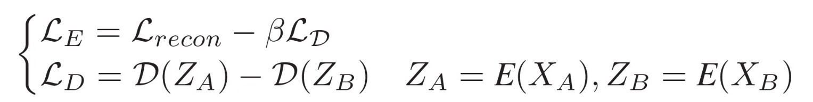
Loss function of adversarial network
We train the embedder and the discriminator with the following coupled loss functions:
Where
X_{A} , X_{B} refer to the vector representation of nodes in communities A, B.
Z_{A}, Z_{B} are their corresponding vector representation in the embedding space.
E and L_{E} represent the embedder function and its relative loss function.
L_{recon} denotes the reconstruction loss of a standard autoencoder.
Similarly, D and L_{D} refer to the discriminator function and its loss.
The discriminator function computes the distance between the distribution of the given embeddings with the initial distribution of the embeddings of nodes of community A.

Slide 11
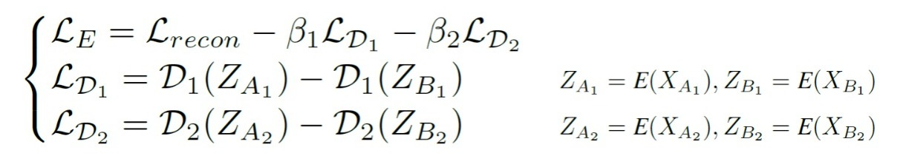
Multiple attributes
In case of multiple attributes, we want our embeddings to have similar distributions for each value of our different sensitive attributes. To do so, we add one discriminator and one extra term to the embedder loss per sensitive attribute. Then during the adversarial training, the embedder plays against a set of discriminators (one discriminator per attribute). For an instance of two sensitive attributes, the embedder and the discriminator’s loss functions would be as follows:

Slide 12
Autoencoder
An autoencoder is a type of artificial neural network used in unsupervised learning to encode and decode data. The primary objective of an autoencoder is to learn a compressed, efficient representation of input data, typically for the purpose of dimensionality reduction or feature learning.
The autoencoder consists of two main parts: an encoder and a decoder.
Encoder: This part of the network compresses the input data into a lower-dimensional representation, also known as the encoding or bottleneck layer. The encoder's role is to capture the essential features of the input data in a condensed form.
Decoder: The decoder takes the encoded representation and reconstructs the original input data as closely as possible. The goal is to have the reconstructed data resemble the input data as much as possible. The decoder helps in learning a meaningful representation that captures the essential information from the input.
The training process involves minimizing the reconstruction error, which is the difference between the input data and its reconstruction.

Slide 13
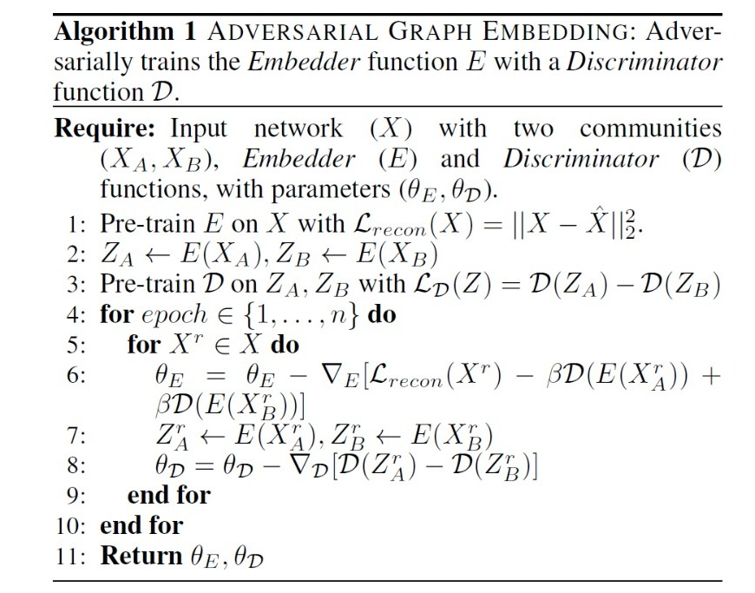
Embedding generation

Slide 14
Seed nodes selection
For the case of one sensitive attribute, our goal is to choose an initial set of influential seeds S. We examine the two following approaches:
Normal Selection: This applies a k-means method on the Z space with k = |S| to select the resulting k cluster centroids as initial seeds.
Fair Selection: In normal selection (above), depending on the network structure, seeds might come from just one community, leading to disparity. To tackle this concern, we propose an alternative method introduced in Algorithm 2 (next page). Assume we want to select |S| = k × s nodes from Z as the initially influenced nodes. We start by performing a k-means algorithm to group all nodes in Z into k clusters. Then, in each cluster, we select the s nearest neighbor's to the centroid and determine whether they are members of community A (NA) or B (NB). We also divide all the nodes of each cluster into two sub-clusters with nodes belonging to A or B. Finally, we exploit the k-means algorithm on each of these sub-clusters using k = |NA| and k = |NB| respectively and obtain the resulting centroids to have selected s = |NA|+|NB| seeds from each of the initial k clusters giving us |S| = k × s seeds from the whole network.

Slide 15
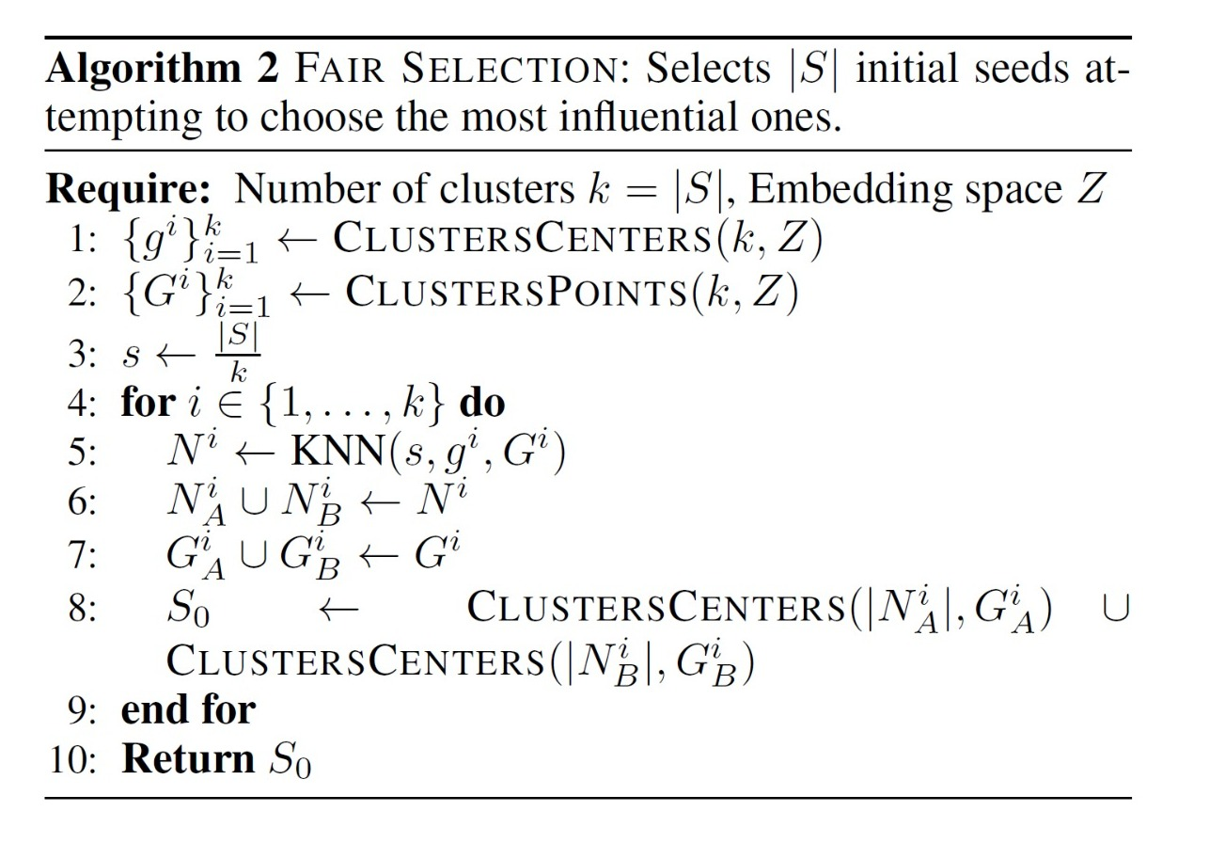
Seed node selection

Slide 16
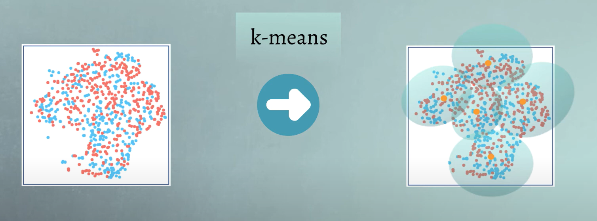
K-means clustering example

Slide 17
Independent Cascade Model
Directed finite G = (V,E)
“Set S” starts out with new behavior
Say nodes with this behavior are “active”
Each edge (v, w) has a probability 𝒑_{𝒗𝒘}
If node 𝒗 is active, it gets one chance to make 𝒘 active, with probability 𝒑_{𝒗𝒘}
𝒑_{𝒗𝒘 :} Probability that node 𝒗 can activate node 𝒘
Each edge fires at most once

Slide 18
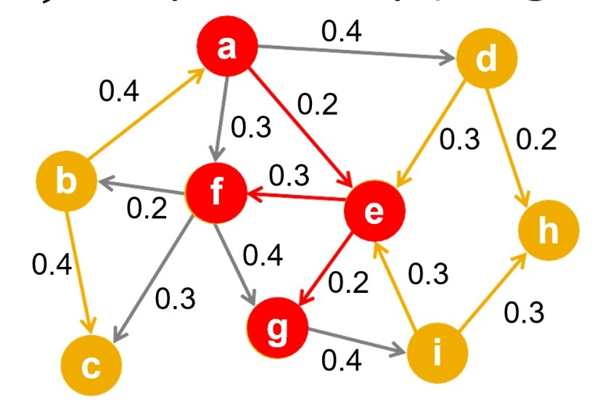
Independent Cascade Model:
Initially some nodes S are active
Each edge (𝒗, 𝒘) has probability (weight) 𝒑_{𝒗𝒘}
When node v becomes active:
It activates each out-neighbor 𝒘 with prob. 𝒑_{𝒗𝒘}
Activations spread through the network

Slide 19
Influence estimation
After the generation of node embeddings we used k-means clustering to find the seed nodes.
For the influence estimation we then use Independent Cascade model on the set of seed nodes that we got earlier to find the estimated influence spread in the social network.

Slide 20
Rice – Facebook dataset
Dataset:- we have taken a sub-graph of Rice university Facebook dataset. we have divide the nodes into 2 categories based on age attribute.
Nodes with age value of 18 or 19 constitute group A or V_{A} and the rest of the nodes form group B, V_{B}.
Group V_{A} has 97 nodes with 513 intra-connections, while group V_{B} has 344 nodes with 7441 intra-connections, and there are 1779 inter-connections between nodes of the two communities.

Slide 21
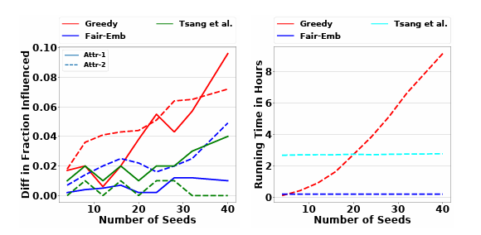
result

Slide 22
Affinity propAgation
Similarity: as an input the algo takes two sets of data, one is similarities between points, which gives how much similar a point is to another point to form an exemplar.
Responsibility:Tells us how much responsible one object is for another.
Availability:Represent how appropriate it would be to consider a point to be its exemplar considering if another point has already has it as an exemplar.
Final criteria for clustering:Each cell is simply sum of the avilability value and responsibility valueatthat location. Then the highest criterion value of each row is then designated as an exemplar. Rows that share the same exemplar end up being in the same cluster

